Slide 1
Capstone Slide Deck
Brian Quigley

Slide 2
Problem Identification
Big Mountain resort needs help in predicting:
Optimum ski pass ticket price
Whether adding or removing features of the park will improve revenue or not

Slide 3
Recommendation and key findings
Model suggests Big Mountain could optimize ticket price charge at $95.00 (expected mean absolute error of $10.00).
In 8 key features of a ski resort, Big Mountain places high in all of them (meaning premium charges would be reasonable)
Closing down up to 5 ski runs could potentially be advantageous to Big Mountain
Increasing the vertical drop to a run and installing a new chair lift to support it could be advantageous to Big Mountain

Slide 4
Modeling results and analysis
Model chosen: random forest regression model
Variable to be predicted: adult weekend ticket price
Target features used in model to predict adult weekend ticket price (from PCA these variables accounted for most of the variability): vertical drop, fastquads, runs, total_chairs, snow making_ac, ad resort_night_skiing_state_ratio

Slide 5
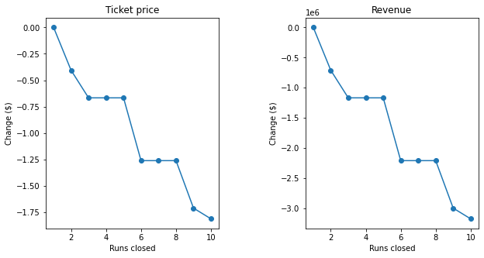
Modeling results and analysis – Effects of Run Closures

Slide 6
Modeling results and analysis
Increasing vertical drop/adding one chair lift – Ticket price increase: $1.99
Adding two acres of snow making area – Ticket price increase: none
Increase longest run by .2 miles and add 4 acres of snow making capability – Ticket price increase: none

Slide 7
Summary and Conclusion
Increase ticket price to at least $85.00 - $95.00 if doing no additional changes to park
Decreasing 1 to 5 runs would lead to a revenue decrease between $0-$110,000 (may be worthwhile depending on run maintenance costs)
Increasing vertical drop and adding chairlift could increase revenue by around $350,000 per year
Increasing other suggested variables would likely lead to more maintenance costs and no additional revenue

